Slide 1

Battle of Neighborhoods
Sheraz Ahmed

Slide 2
Introduction
The purpose of this Project is to help people in exploring better facilities around their neighborhood. It will help people making smart and efficient decision on selecting great neighborhood out of numbers of other neighborhoods in Downtown Toronto, Toronto.

Slide 3
Problem Statement
The major purpose of this project, is to suggest a better neighborhood in a new city for the person who are shiffting there. Social presence in society in terms of like minded people. Connectivity to the airport, bus stand, city center, markets and other daily needs things nearby.

Slide 4
Data gathering
We Will use Toronto Neighborhood dataset that we scrapped from wikipedia in Week 3. Dataset will be consisting of Borough, Neighborhood, latitude and longitude, zip codes.
Data Link: https://en.wikipedia.org/wiki/List_of_postal_codes_of_Canada:_M

Slide 5
Approach
This project would use Four-square API as its prime data gathering source. Using credentials of Foursquare API features of near-by places of the neighborhoods would be mined. To compare the similarities of two cities, we decided to explore neighborhoods, segment them, and group them into clusters to find similar neighborhoods in a big city like New York and Toronto. To be able to do that, we need to cluster data which is a form of unsupervised machine learning: k-means clustering algorithm

Slide 6
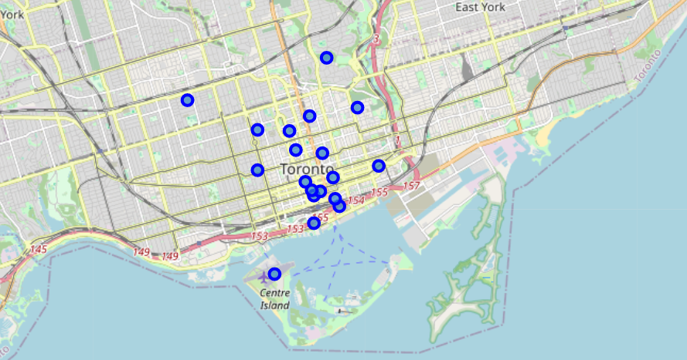
Downtown Toronto

Slide 7
Results
As a result of implementation of our proposed solution, we found out that the average housing price around the toronto downtown is 335430.10 USD, and the highest price is 589900.00 USD, and lowest is 165000.00 USD. And for the best schools finding, we have found out that the average school rating arounf the toronto downtown neighborhood is 6.1 on the scale of 1 to 10, with 8 schools having 10 rating. Our finding will be really helpful for the people planning to move to toronto downtown or its neighborhoods.

Slide 8
Future Work
This project can be continued for making it more precise in terms to find best house in Downtown Toronto. Best means on the basis of all required things(daily needs or things we need to live a better life) around and also in terms of cost effective.

Slide 9
Link to Full Project
Github Link:
https://github.com/Sherazch/Coursera_Capstone/blob/master/Battle%20of%20Neighborhoods%20Code.ipynb

Slide 10
Thankyou!

